Slide 1
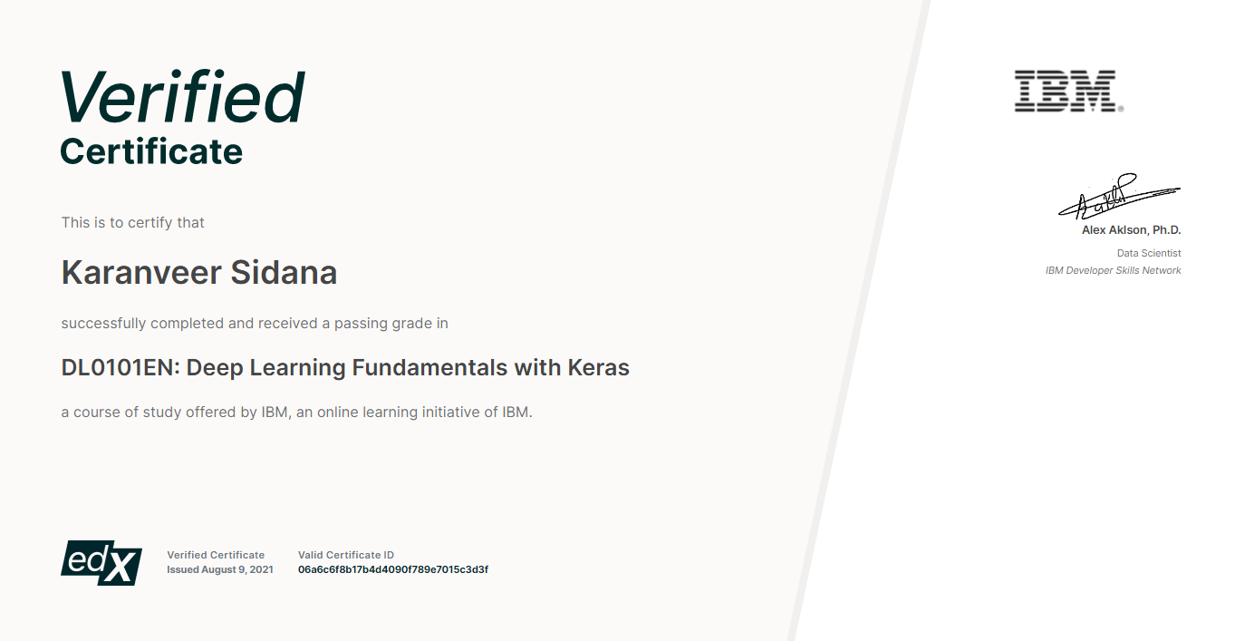
Deep Learning Project : Realtime Human Detection & Counter

Slide 2

Course Takeaways
Neural networks
Pre-Trained Models
Regression models
Classification models
Supervised deep learning models(CNN,RNN)
Unsupervised learning models (autoencoders)

Slide 3


About Project
Realtime Human Detection & Counter is based on MobileNet Model used to detect and keep track of number of people in a particular place.
Keeps counter of people entering and exiting the place.
Designed for Video Input.

Slide 4
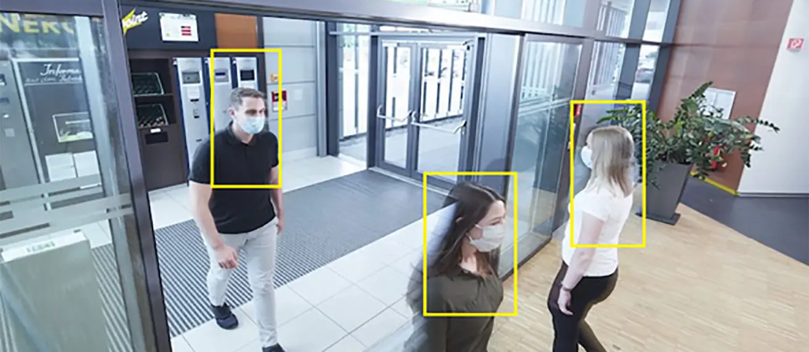

Motivation & Use Case
Monitoring social gatherings during COVID-19 Pandemic.
To alarm the authorities for the violations of COVID-19 restrictions imposed by the Government.

Slide 5





Framework
MobileNet (Keras)
OpenCV
Numpy
Scipy

Slide 6
Workflow
Input Video is loaded
Data Preprocessing( Each Frame)
Object Detection (MobileNet)
Object Tracking(Euclidean distance)
Counting

Slide 7
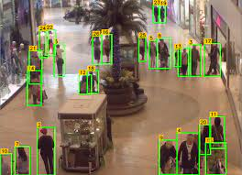
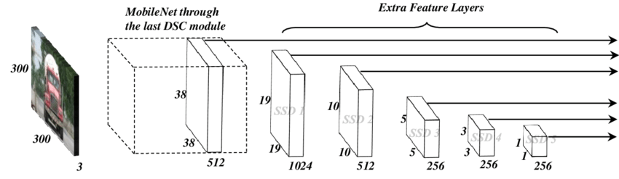
Model Selection
As a lightweight deep neural network, MobileNet has fewer parameters and higher classification accuracy.
In order to further reduce the number of network parameters and improve the classification accuracy, dense blocks that are proposed in DenseNets are introduced into MobileNet.

Slide 8
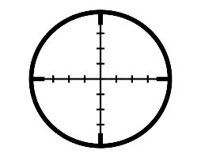
Object Tracking
Assign an ID to every detected person draw a box over there and measure the centroid of the box.
Use the Euclidean distance to detect change in centroid.
If the centroid moves out of frame in ‘up’ direction, decrease the counter, If the direction is ‘down’ , increase the counter.

Slide 9
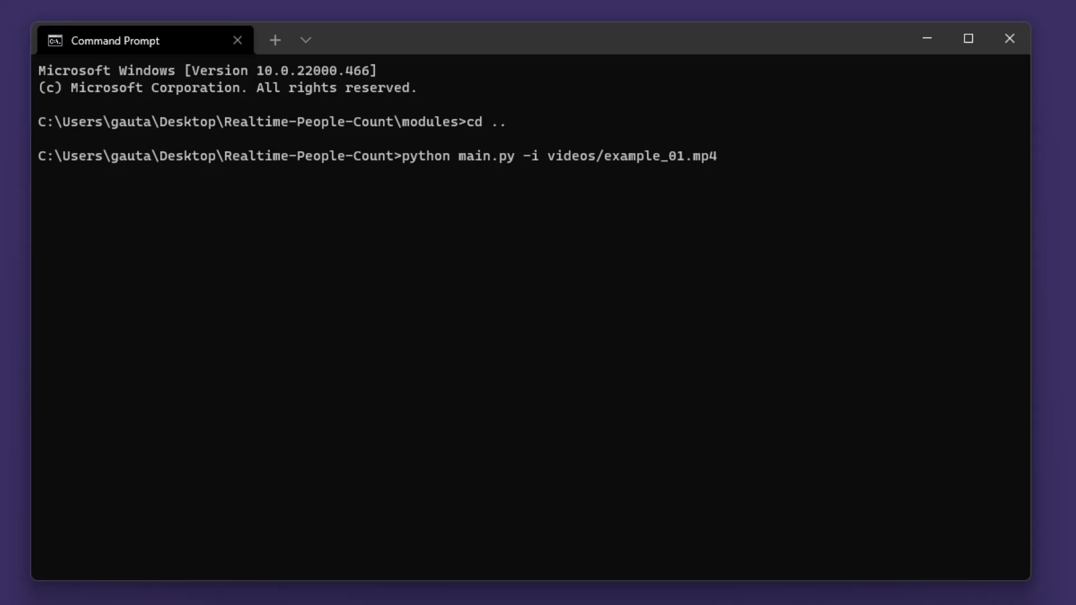
DEMO

Slide 10
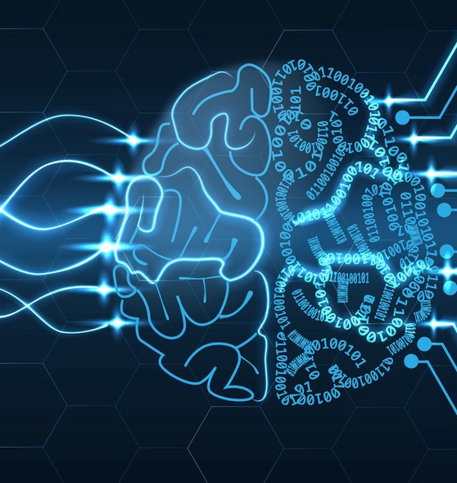
THE END

